Slide 1
CIS387/ECE387
Digital Forensics I
Windows Data Acquisition
Notes:
Guide to Computer Forensics and Investigations Fifth Edition
Chapter 3
Data Acquisition

Slide 2
Collect volatile data from Windows
System Information
Processes Information
Network Information
Logon users
Clipboard contents
Command History
Tools to download
  https://docs.microsoft.com/en-us/sysinternals/

Slide 3
Memory forensics – Why?
Used by forensic investigators in
  Malware detection
    objects hidden by rootkits (processes, threads, connections etc.)
    memory-resident malware
    unpacked/unencrypted images
  Password recovery
  ……

Slide 4
Physical Memory Acquisition
Host-based
  winen.exe from Guidance Software
  MemoryDD from ManTech
  FTK imager from Access Data
  Belkasoft Live RAM Capturer
Remote
  F-response by By Agile Risk Management LLC
  FTK from Access Data

Slide 5
_x000b_Cold Boot Attack_x000b_Demo: https://www.youtube.com/watch?v=Ej-Nr79bVjg
A type of side channel attack in which an attacker with physical access to a computer performs a memory dump of a computer's RAM by performing a hard reset of the target machine.
Typically, cold boot attacks are used to retrieve encryption keys from a running operating system for malicious or criminal investigative reasons.
The attack relies on the data remanence property of DRAM and SRAM to retrieve memory contents that remain readable in the seconds to minutes after power has been removed.
Notes:
DRAM → needs to be constantly refreshed (used for standard memory) (uses a lot more power also because it needs to be constantly refreshed).
SRAM → just need to maintain power (no need to refresh); used for cache; smaller, more expensive, faster (uses a lot less power than DRAM because the expensive technology circuit allows charge to be kept in data capacitors (bits) as long as there is a voltage applied to system → there is power applied to system).
So, we can boot from another device (i.e. not the encrypted hard drive) and still access the SRAM and DRAM if you restore power fast enough and/or access the RAM before it discharges (and thus all bits = data fades/is lost.).
So, safest way to make sure your encryption cannot be bypassed is to completely shutdown the computer and make sure it has a prompt from encryption software before even booting (but this can still be bypassed if someone steals the physical device even after it is shutdown if they acquire it fast enough before the memory fades).
Also: in order to make memory fade (dissipate/discharge) slower is by cooling it down; this can make the discharge slow by great factors (for example: from 3 minutes, to 10 minutes), and also we have error-correction and prediction software to repair any data lost (discharged) upon trying to acquire RAM if power was lost (and not restored, or restored late enough that some memory fades).

Slide 6
Memory Analysis Tools
WindowsSCOPE by WindowsSCOPE Cyber Forensic
Redline/Memoryze from FireEye
The Volatility Framework by the Volatility Foundation
Rekall Memory Forensics Framework from Google
Google Rapid Response (GRR)

Slide 7
The Volatility Framework
Volatility is installed on SIFT Workstation
A Python-based toolkit can extract information from both Windows and Linux/Unix memory images
  imageinfo, pslist, psscan, thrdscan, dlllist, modules, sockets, sockscan, connections, connscan, hivelist, malfind…
  vol.py –f memfile imageinfo
  vol.py --profile=WinXPSP3x86 connscan –f memfile
Example:
  http://sketchymoose.blogspot.de/2012/11/memory.html

Slide 8
Other volatility plugins
Cryptoscan
  Based on “RAM is Key: Extracting Disk Encryption Keys From Volatile Memory” by Brian Kaplan,
  Scans a memory image to recover TrueCrypt passphrases
  vol.py --profile= WinXPSP3x86 cryptoscan –f memfile
Suspicious
  Displays the command line used in “suspicious” processes
hivelist and hivescan
  Finds hive offsets in memory images

Slide 9
Rekall Memory Forensics Framework
Google’s memory acquisition and analysis framework
  For Windows, Linux, and Mac
http://www.rekall-forensic.com/
http://www.rekall-forensic.com/docs/Manual/tutorial.html

Slide 10
Google Rapid Response (GRR)
GRR - GRR Framework
  https://github.com/google/grr-doc
  An incident response framework
  Focus on remote live forensics
  Using both Rekall and Sleuthkit
  Client: python agent for Linux, OS X, and Windows
  Server: Ubuntu Server
Notes:
Allows for rapid live analysis by running the digital forensics tools from the server; software application for the tools must also be installed on the client (software establishes TCP connection).

Slide 11
GRR (Cont’d)
GRR server sends action requests (flow or hunt) to clients
  actions are blocks of code executed by the agent on the endpoint machine, then return the results
Investigator initiates requests through the web-based GUI or the GRR console
  OS-level and raw file system using SleuthKit
  Memory acquisition and analysis using Rekall
Communication between client and server using AES256 encryption

Slide 12
Memory anti-forensics
Dementia (Dec. 2012)
  modifies the memory dump of a machine in its acquisition mode.
  defeats memory analysis on Windows OS by hiding operating system objects (processes)
  http://events.ccc.de/congress/2012/Fahrplan/events/5301.en.html
Notes:
Acquisition mode: a mode from an anti forensics digital tool (application) that is detected when data is attempted to be acquired remotely.

Slide 13
Attention-deficit-disorder (ADD)
Physical memory anti-analysis tool designed to pollute memory with fake artifacts
Shmoocon 2014
Proof of concept for Windows 7 SP1 x86
https://code.google.com/p/attention-deficit-disorder/

Slide 14
LAB 3 NOTES
Every process has a parent (except root process of course).
  This forms a process tree
  Run the pstree function from the vol.py program.
  Some tools can purposely disrupt this tree so that processes are hidden
    But we can do psscan in order to scan all process control blocks (PCBs); this is slower, but shows ALL processes running even the ones broken from the linked list so that it would not show up in the tree (pstree uses the tree linked list of processes to build the tree; but malicious people can unlink their process so it does not show up in that link list).

Slide 15
LAB 3 NOTES
When we run connscan (for connection scan) vol.py command, we can see all connections (IP + port + process ID), then we can go to that process ID and see what the name of the process (executable file → .exe) is to see if it is suspicious.
  For example, port 80 is HTTP connection, so it should be associated with a process that is a web browser, like Chrome.exe.
  But a malicious process could be using HTTP protocol to do other activities; so executable will be named something other than a web browser.

Slide 16
LAB 3 NOTES
printkey function from vol.py to see system register keys to check if any malware programs will run when a system reboots and runs a system function at startup (startup functions often serve as wrapper functions for child functions that need to run).

Slide 17
Capturing an Image with AccessData FTK Imager Lite (Lite = free version)
Included with AccessData Forensic Toolkit
  https://accessdata.com/product-download
Designed for viewing evidence disks and disk-to-image files
Makes disk-to-image copies of evidence drives
  At logical partition and physical drive level
  Can segment the image file
Evidence drive must have a hardware write-blocking device
  Or run from a Live CD, such as Mini-WinFE
Notes:
Capturing an Image with AccessData FTK Imager Lite
Included with AccessData Forensic Toolkit
Designed for viewing evidence disks and disk-to-image files
Makes disk-to-image copies of evidence drives
At logical partition and physical drive level
Can segment the image file
Evidence drive must have a hardware write-blocking device
Or run from a Live CD, such as Mini-WinFE
Remember: image file == either a compressed or bit copy of the a disk (for digital forensics, we want bit copy image files of course).
Also: an image of an image == a direct copy of an image or a decompression of an image into a full image file (bit copy of uncompressed image).
Remember: with compression: trade space for time; takes longer to run compression algorithm to compress data; but takes up less space.
Note for digital forensic tools: when compression is done; needs to be lossless so that when we decompress we recover original data 100% (use hash algorithm to check for integrity of data).

Slide 18
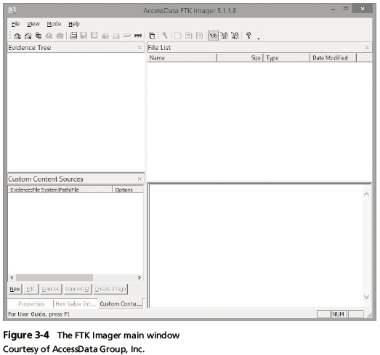
Capturing an Image with AccessData FTK Imager Lite
Notes:
Capturing an Image with AccessData FTK Imager Lite
Figure 3-4 The FTK Imager main window

Slide 19
Capturing an Image with AccessData FTK Imager Lite
FTK Imager can’t acquire a drive’s host protected area
Use a write-blocking device and follow these steps
  Boot to Windows
  Connect evidence disk to a write-blocker
  Connect target disk to write-blocker
  Start FTK Imager Lite
  Create Disk Image - use Physical Drive option
  See Figures on the following slides for more steps
Notes:
Capturing an Image with AccessData FTK Imager Lite
FTK Imager can’t acquire a drive’s host protected area
Use a write-blocking device and follow these steps
Boot to Windows
Connect evidence disk to a write-blocker
Connect target disk to write-blocker
Start FTK Imager Lite
Create Disk Image - use Physical Drive option
See Figures on the following slides for more steps

Slide 20
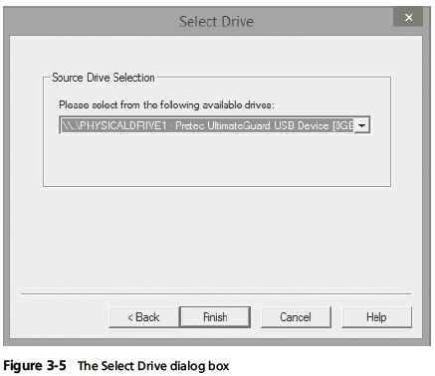
Capturing an Image with AccessData FTK Imager Lite
Notes:
Capturing an Image with AccessData FTK Imager Lite
Figure 3-5 The Select Drive dialog box

Slide 21
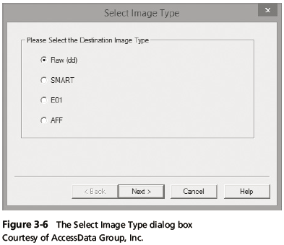
Capturing an Image with AccessData FTK Imager Lite
Notes:
Capturing an Image with AccessData FTK Imager Lite
Figure 3-6 The Select Image Type dialog box

Slide 22
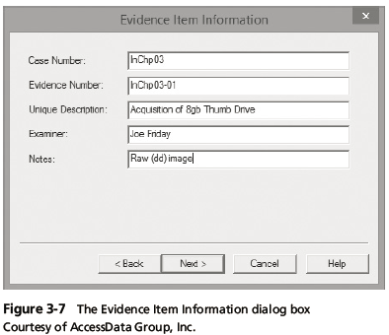
Capturing an Image with AccessData FTK Imager Lite
Notes:
Capturing an Image with AccessData FTK Imager Lite
Figure 3-7 The Evidence Item dialog box

Slide 23
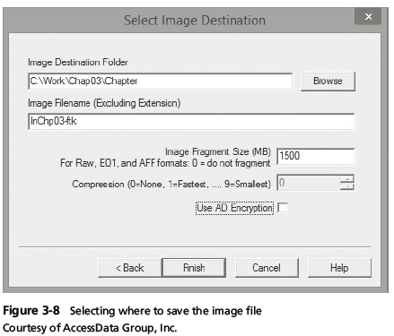
Capturing an Image with AccessData FTK Imager Lite
Notes:
Capturing an Image with AccessData FTK Imager Lite
Figure 3-8 Selecting where to save the image file

Slide 24
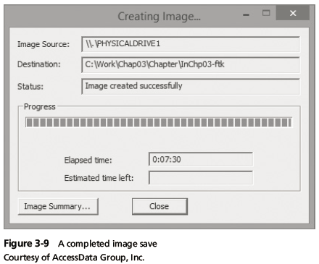
Capturing an Image with AccessData FTK Imager Lite
Notes:
Capturing an Image with AccessData FTK Imager Lite
Figure 3-9 A completed image save

Slide 25
EnCase Forensic Imager
Free to download and use
  https://www.encase.com/products/Pages/Product-Forms/Forensic-Imager-download.aspx
Provides easy viewing and browsing of potential evidence files including folder structures and file metadata
Note When using the Imager to create a forensic image of a hard drive, make sure your are using a write-blocking mechanism.

Slide 26
Preview vs Acquire
View and search files without acquiring an image (read only)
Immediately determine whether relevant evidence exists on a computer
Alert: Have to use a write blocker to ensure no changes to the original drive.

Slide 27
Windows Validation Methods
Windows has no built-in hashing algorithm tools for computer forensics
  Third-party utilities can be used
  http://www.slavasoft.com/hashcalc/
Commercial computer forensics programs also have built-in validation features
  Each program has its own validation technique
Raw format image files don’t contain metadata
  Separate manual validation is recommended for all raw acquisitions
Notes:
Windows Validation Methods
Windows has no built-in hashing algorithm tools for computer forensics
Third-party utilities can be used
Commercial computer forensics programs also have built-in validation features
Each program has its own validation technique
Raw format image files don’t contain metadata
Separate manual validation is recommended for all raw acquisitions

Slide 28
Performing RAID Data Acquisitions
Acquisition of RAID drives can be challenging and frustrating because of how RAID systems are
  Designed
  Configured
  Sized
Size is the biggest concern
  Many RAID systems now have terabytes of data
RAID is a lower-level (hardware architecture) technology; it is hidden from OS; so logically the OS can implement RAID.
Notes:
Performing RAID Data Acquisitions
Acquisition of RAID drives can be challenging and frustrating because of how RAID systems are
Designed
Configured
Sized
Size is the biggest concern
Many RAID systems now have terabytes of data

Slide 29
Understanding RAID
Redundant array of independent (formerly “inexpensive”) disks (RAID)
  Computer configuration involving two or more disks
  Originally developed as a data-redundancy measure
RAID 0 (mostly uses stripping)
  Provides rapid access and increased storage
  Biggest disadvantage is lack of redundancy
RAID 1
  Designed for data recovery
  More expensive than RAID 0
Notes:
Understanding RAID
Developed by computer scientist at University of California at Berkley
Redundant array of independent (formerly “inexpensive”) disks (RAID)
Computer configuration involving two or more disks
Originally developed as a data-redundancy measure
RAID 0
Provides rapid access and increased storage
Biggest disadvantage is lack of redundancy
RAID 1
Designed for data recovery
More expensive than RAID 0
RISC (Reduced Instruction Set Computer) – ARM architectures (like Android) – more energy efficient, less complex (instructions all the same size)
CISC – Complex Instruction Set Computer – X86 (variable sized instructions = more complex).
One advantage of RAID: Stripping (Sharding) (better r/w speed, and increased storage size logically, but no redundancy).
Can break a file into multiple blocks and distribute those blocks among different disks (for example, with two disks: allows two disks to work in parallel = double read and write speed of a system! This is because most systems are limited by the bottleneck which is usually the disk read and write; data can be transmitted electronically much faster than disks can read and write, so if you could load balance by writing and reading from multiple different disks, you can magnify the r/w speed by a factor of the number of disks involved.).
Another technology advantage of RAID: Mirroring.
Reading can be faster since more users can read using both disks
But writing is slower because each time data is written to one disk it must be mirrored on all the others.
One issue to overcome with writing is consitency: have to make a way to make sure all disks are updated with the most current data of the most updated disk – they need to always be mirrored before users of the system read or write to the system; this can be very challenging and error rate needs to be extremely low (on the order of 99.9999999999 accuracy of consistency between all disks at all times in the system: slows down writing! And potentially reading at some instances while writing is occuring).
A final technology advantage: Parity
Parity block stores any bad blocks of other disks in the array so we can have data recovery and reliability.
Occurs at the bit level or block/byte level (as desired), so that even individually bad bits from a disk can be recovered by the parity disk.

Slide 30
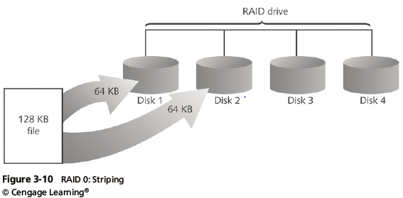
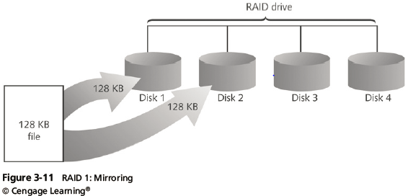
Understanding RAID
Notes:
Understanding RAID
Figure 3-11 RAID 1: Mirroring

Slide 31
Understanding RAID
RAID 2
  Similar to RAID 1
  Data is written to a disk on a bit level
  Has better data integrity checking than RAID 0
  Slower than RAID 0
  Has bit-level parity available
RAID 3
  Uses byte-level stripping and dedicated parity
RAID 4
  Uses block-level stripping and dedicated parity
Notes:
Understanding RAID
RAID 2
Similar to RAID 1
Data is written to a disk on a bit level
Has better data integrity checking than RAID 0
Slower than RAID 0
RAID 3
Uses data stripping and dedicated parity
RAID 4
Data is written in blocks

Slide 32
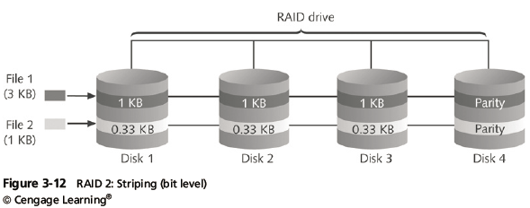
Understanding RAID
Notes:
Understanding RAID
Figure 3-12 RAID 2: Striping (bit level)

Slide 33
Understanding RAID
RAID 5
  Uses block-level stripping and distributed parity
  Places parity recovery data on each disk
RAID 6 (can have multiple parity blocks for more redundancy → can tolerate more than one failure; but design is more complex)
  Redundant distributed parity on each disk
RAID 10, or mirrored striping (stripping + mirroring)
  Also known as RAID 1+0
  Combination of RAID 1 and RAID 0
Notes:
Understanding RAID
RAID 5
Similar to RAIDs 0 and 3
Places parity recovery data on each disk
RAID 6
Redundant parity on each disk
RAID 10, or mirrored striping
Also known as RAID 1+0
Combination of RAID 1 and RAID 0
In today’s data venters: we use similar techniques (sharding, mirroring, parity), but each disk is independent (separate controller; for example, instead of one server controlling multiple disks logically, the server instead controls multiple controllers → where each disk has its own controller).

Slide 34
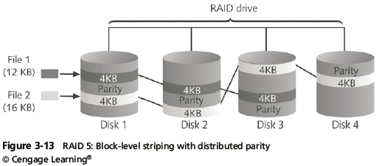
Understanding RAID
Notes:
Understanding RAID
Figure 3-13 RAID 5: Block-level striping with distributed parity

Slide 35
Acquiring RAID Disks
Address the following concerns
  How much data storage is needed?
  What type of RAID is used?
  Do you have the right acquisition tool?
  Can the tool read a forensically copied RAID image?
  Can the tool read split data saves of each RAID disk?
Copying small RAID systems to one large disk is possible (but for large systems, this is infeasible).
Notes:
Acquiring RAID Disks
Address the following concerns
How much data storage is needed?
What type of RAID is used?
Do you have the right acquisition tool?
Can the tool read a forensically copied RAID image?
Can the tool read split data saves of each RAID disk?
Copying small RAID systems to one large disk is possible

Slide 36
Acquiring RAID Disks
Vendors offering RAID acquisition functions
  Technology Pathways ProDiscover
  Guidance Software EnCase
  X-Ways Forensics
  AccessData FTK
  Runtime Software
  R-Tools Technologies
Occasionally, a RAID system is too large for a static acquisition
  Retrieve only the data relevant to the investigation with the sparse or logical acquisition method
Notes:
Acquiring RAID Disks
Vendors offering RAID acquisition functions
Technology Pathways ProDiscover
Guidance Software EnCase
X-Ways Forensics
AccessData FTK
Runtime Software
R-Tools Technologies
Occasionally, a RAID system is too large for a static acquisition
Retrieve only the data relevant to the investigation with the sparse or logical acquisition method

Slide 37
Using Remote Network Acquisition Tools
You can remotely connect to a suspect computer via a network connection and copy data from it
Remote acquisition tools vary in configurations and capabilities
Drawbacks
  Antivirus, antispyware, and firewall tools can be configured to ignore remote access programs
  Suspects could easily install their own security tools that trigger an alarm to notify them of remote access intrusions
Notes:
Using Remote Network Acquisition Tools
You can remotely connect to a suspect computer via a network connection and copy data from it
Remote acquisition tools vary in configurations and capabilities
Drawbacks
Antivirus, antispyware, and firewall tools can be configured to ignore remote access programs
Suspects could easily install their own security tools that trigger an alarm to notify them of remote access intrusions
You need to generally have control of the network and end to end devices involved in the acquisition in order to do data acquisition of data.

Slide 38
Remote Acquisition with ProDiscover
Remote connection security features
  Password Protection
  Encryption
  Secure Communication Protocol
  Write Protected Trusted Binaries
  Digital Signatures
Notes:
Remote Acquisition with ProDiscover
Remote connection security features
Password Protection
Encryption
Secure Communication Protocol
Write Protected Trusted Binaries
Digital Signatures

Slide 39
Remote Acquisition with EnCase Enterprise
Remote acquisition features
  Remote data acquisition of a computer’s media and RAM data
  Integration with intrusion detection system (IDS) tools
  Options to create an image of data from one or more systems
  Preview of systems
  A wide range of file system formats
  RAID support for both hardware and software
Notes:
Remote Acquisition with EnCase Enterprise
Remote acquisition features
Remote data acquisition of a computer’s media and RAM data
Integration with intrusion detection system (IDS) tools
Options to create an image of data from one or more systems
Preview of systems
A wide range of file system formats
RAID support for both hardware and software

Slide 40
Remote Acquisition with F-Response
F-Response
  A vendor-neutral remote access utility
  Designed to work with any digital forensics program
  Sets up a security read-only connection
    Allows forensics examiners to access it
Four different version of F-Response
  Enterprise Edition, Consultant + Convert Edition, Consultant Edition, and TACTICAL Edition
Notes:
Remote Acquisition with F-Response
F-Response
A vendor-neutral remote access utility
Designed to work with any digital forensics program
Sets up a security read-only connection
Allows forensics examiners to access it
Four different version of F-Response
Enterprise Edition, Consultant + Convert Edition, Consultant Edition, and TACTICAL Edition

